Slide 1

[Virtual Waiter]

Slide 2
Summary
We hit a big milestone test launching the tablets. We conducted a survey for the 50 customers that participated in our test launch. For the test launch, we asked the customers to engage with the newly implemented tablets, as if they were participating in a typical restaurant experience. The customers were sent a digital survey after their experience ended.

Slide 3
Overview
We conducted this survey to measure:-
Customer satisfaction with the new tablet system
How well our staff are trained to use the tablets
Whether the average ticket, wait, and checkout time decreased or not after implementing the new system
How efficient and easy to use the new tablet system
The impact of the new system in reducing incorrect orders

Slide 4
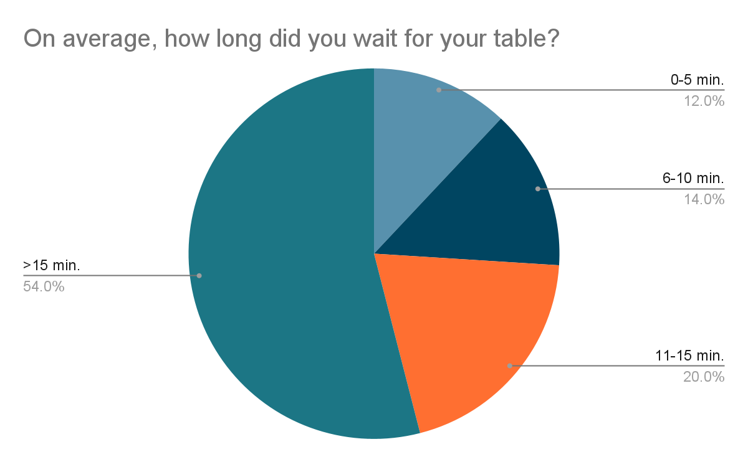
Findings

Slide 5
Next Steps
The survey result indicated some issues regarding prolonged wait times for tables and delayed order delivery
74% of customers waited longer than 10 minutes to be seated “which is longer than targeted <10 mins”
86% of customers received their order before 30 minutes, while 56% received it before 20 minutes
Hence, we need to focus on reducing the order delivery time to be shorter than 15 minutes which will consequently reduce the average wait time
Discuss hiring more back of house staff to reach this target

Slide 6
Next Steps
There is still room for improvement, so I recommend:
Discuss the idea of adding an option of choosing a waiter
Add more videos and promotions on tablet as people find them interesting
We need to work on increasing our correct orders from 72% to 98%
Creating messaging about payment portal security to display on the tablets led to 62% of customers feeling confident paying through the tablet
Adding a newsletter was a great idea as 78% signed up for it
Discuss an alternative to the Birthday Club feature as only 16% signed up for it

